Slide 1
Data & Delegation in Apps
Ritika Agarwal

Slide 2



RITIKA AGARWAL
Cloud Specialist
Applied Info Services India Pvt Ltd
@Agarwal_ritika
agarwalritika08@gmail.com

Slide 3
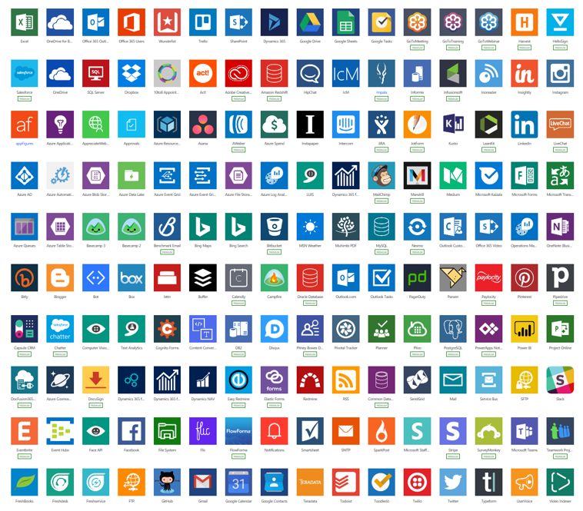
#DataConnectors
Image Source: https://michalguzowski.pl/wp-content/uploads/2019/06/image-3.png

Slide 4
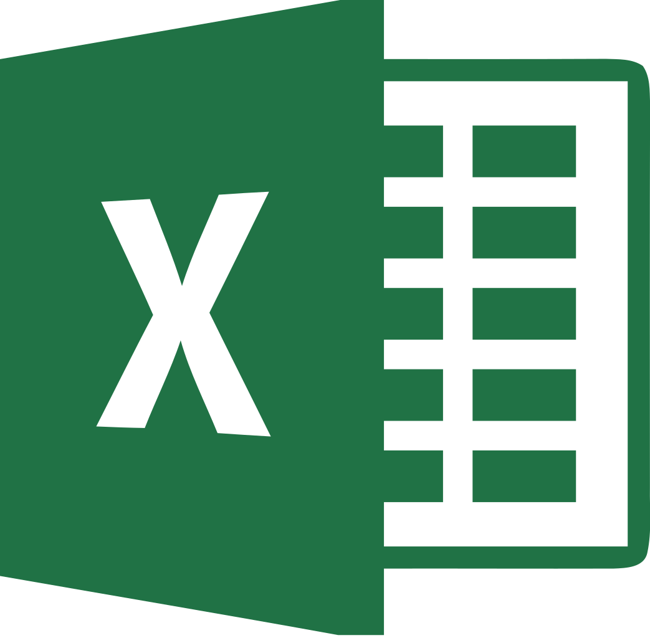
Excel to PowerApps
Use Excel as a datasource.
Data must be formatted as a Table.
Image Source: https://upload.wikimedia.org/wikipedia/commons/thumb/8/86/Microsoft_Excel_2013_logo.svg/1043px-Microsoft_Excel_2013_logo.svg.png

Slide 5
Delegation
Need to minimize data moving over the network
Delegation Limits
Delegable data sources
Common Data Service
SharePoint
SQL Server

Slide 6
Delegable Functions
Non-Delegable Functions
Filter, Search, LookUp
StartsWith, EndsWith
AND, OR, NOT
In
=, <>, >=, <=, >, <
+, -
Sum, Average, Min, and Max
First, FirstN, Last, LastN
Choices
Concat
Collect, ClearCollect
CountIf, RemoveIf, UpdateIf
GroupBy, Ungroup
CountRows, CountA, and Count

Slide 7

SharePoint to PowerApps
Use SharePoint list as DataSource
Image Source https://upload.wikimedia.org/wikipedia/commons/thumb/3/31/Microsoft_Office_SharePoint_%282018%E2%80%93present%29.svg/1200px-Microsoft_Office_SharePoint_%282018%E2%80%93present%29.svg.png

Slide 8
Collections
Store Temporary Data from DataSources.
Data remains for the current session only.
Can be used to overcome delegation.
Reduces to-and-fro requests to the datasource.

Slide 9
Editable Gallery
Ability to edit data and perform bulk update.

Slide 10
Cascading Dropdowns
Ability to filter only related data in subsequent dropdowns.

Slide 11
Any Questions?

Slide 12

Please fill out the survey! & Win Swags!!
https://www.powerplatformbootcamp.com/survey

Slide 13

Thank You For Attending
@Agarwal_ritika
agarwalritika08@gmail.com

